Slide 1
Elgamal Cryptographic System
Collected by: Abhishek Dewan
Lecturer, Cyptrography Trinity Int’l College

Slide 2
Elgamal Cryptographic System
ElGamal encryption is a public-key cryptosystem.
It uses asymmetric key encryption for communicating between two parties and encrypting the message.
This cryptosystem is based on the difficulty of finding discrete logarithm in a cyclic group that is even if we know gª and g^{k}, it is extremely difficult to compute g^{ak}.

Slide 3

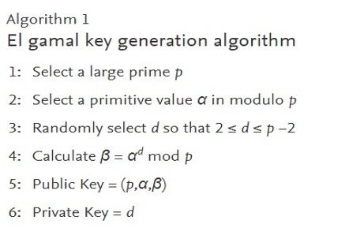
g
X
Y

Slide 4
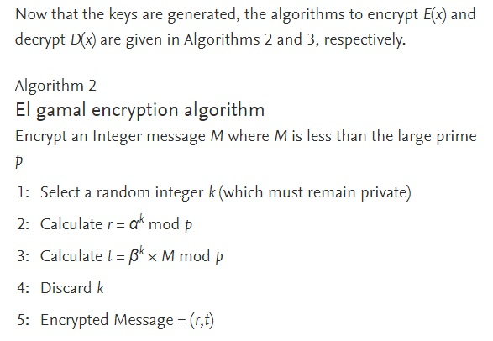

Slide 5
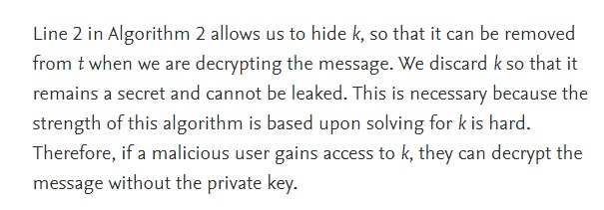

Slide 6
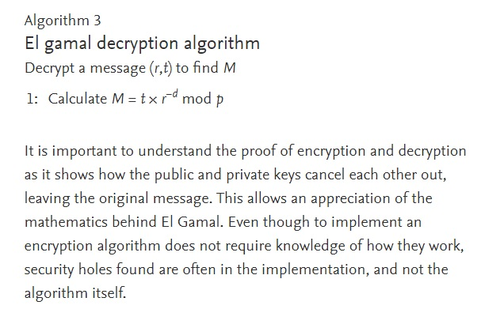

Slide 7
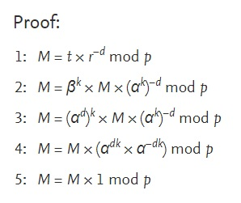

Slide 8

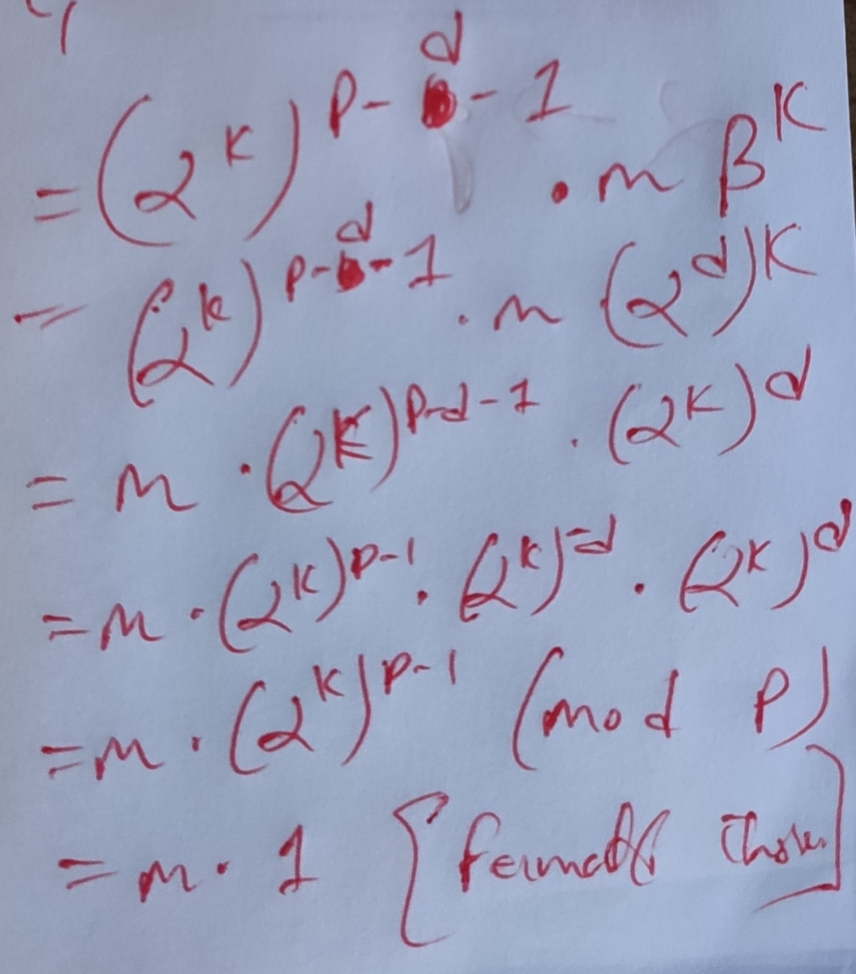
Calculate :

Slide 9
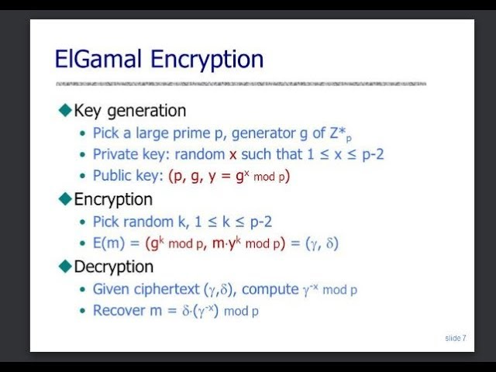

Slide 10
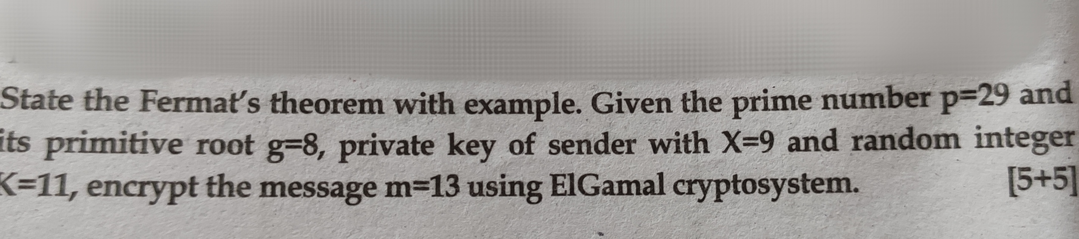
?? TU (2076)

Slide 11
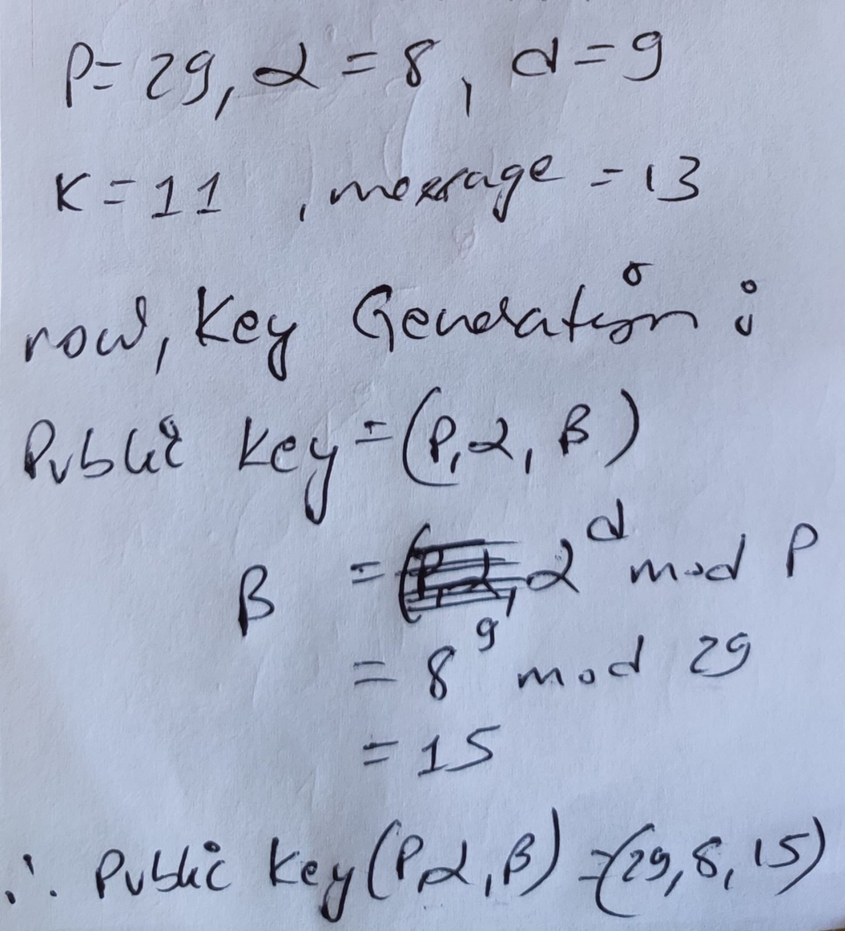

Slide 12
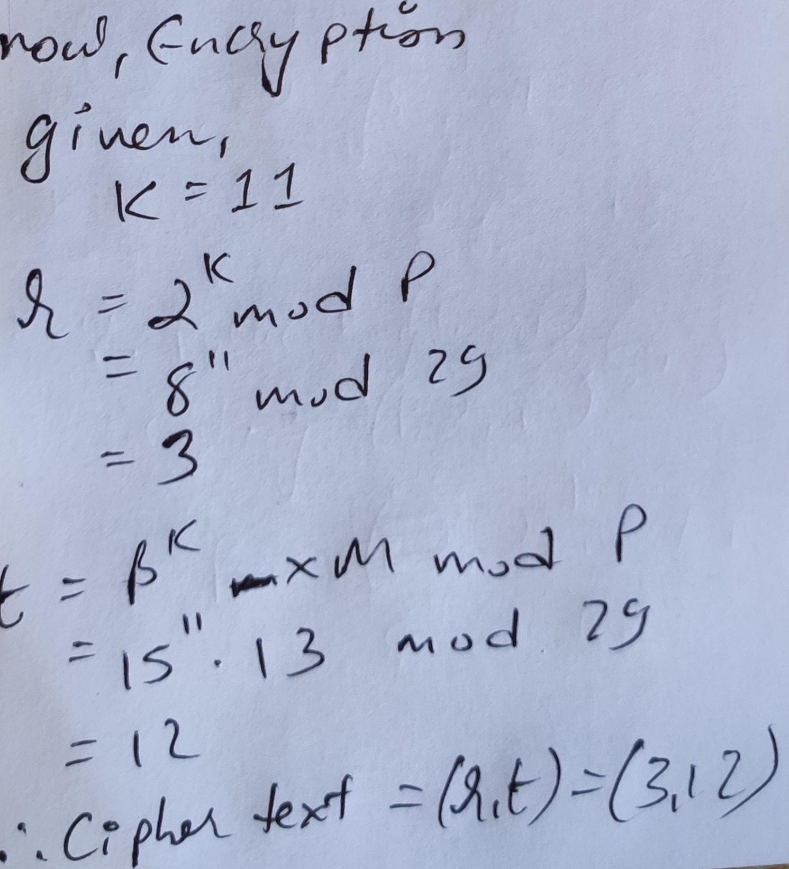

Slide 13
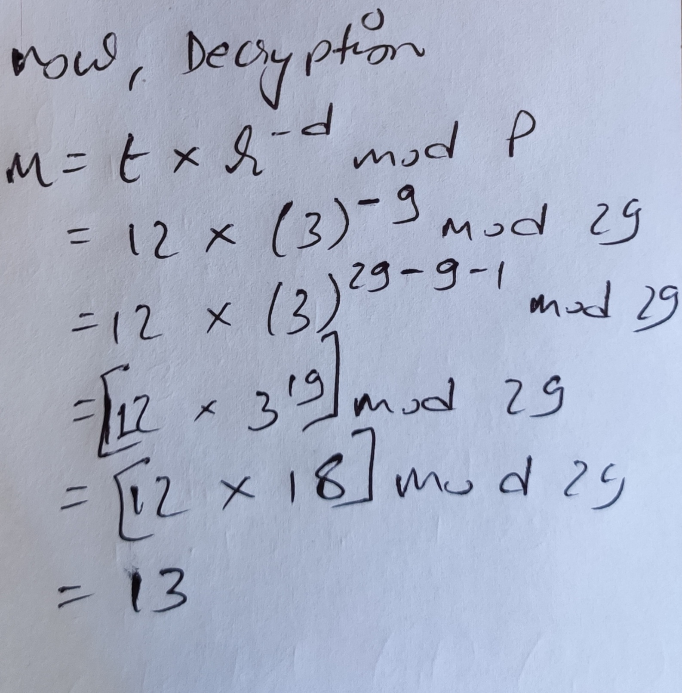

Slide 14
?? Classwork
Encrypt and Decrypt using Elgamal cryptosystem:
P=17 , = 60 , d = 5 ,K = 10, message = 13

Slide 15
End of Unit ‘3’

Slide 16
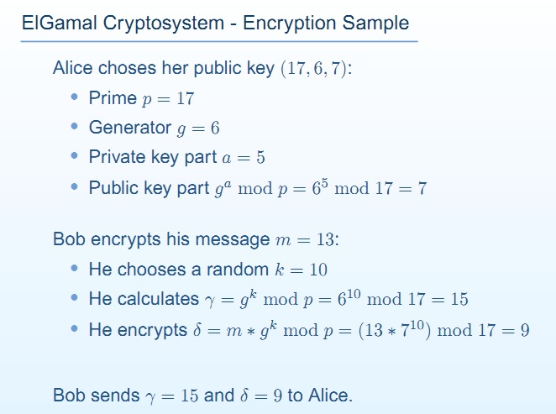
Extra:

Slide 17
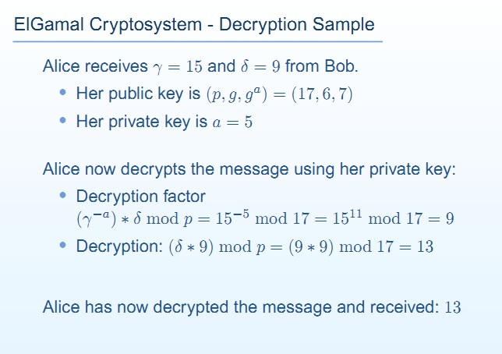
d
-d

Slide 18
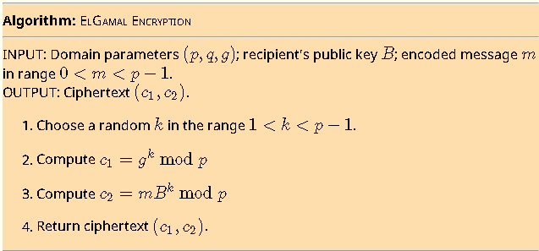

Slide 19
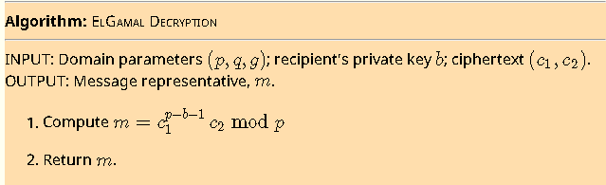

Slide 20
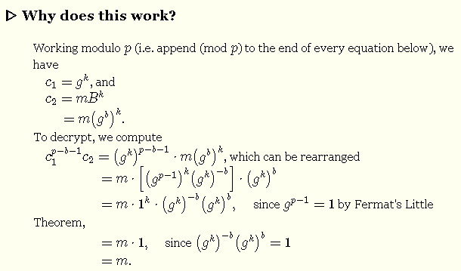

Slide 21
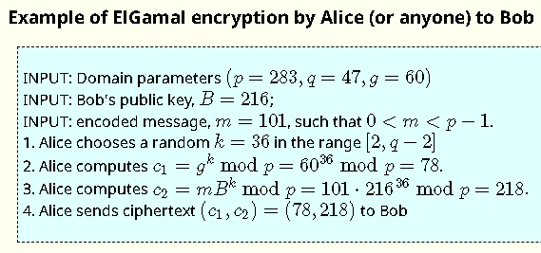

Slide 22
